Slide 1
PreCrash: Predictive Collision-intelligence system
H26SCT03
Krishnaswamy K V(LEAD) || Monishwar B || Manoranjan V S
Chennai Institute of Technology
July 2026

Slide 2
Problem Statement
The Problem
CCTV systems only record accidents — they don't prevent them
Traffic monitoring can't predict collisions in real time
No integrated AI system links detection, prediction, risk assessment & emergency response
Our Objectives
Detect & track road hazards in real time from live camera feeds
Predict collision risk before impact via motion forecasting + fuzzy risk scoring
Automate the response — from near-miss logging to hospital dispatch
July 2026

Slide 3
Existing Solutions and Identified Gaps
Existing Solutions
CCTV surveillance — passively records footage for post-incident review
Traffic monitoring systems — track flow and violations, not collision risk
Vehicle-level ADAS / collision-warning — limited to a single vehicle, no city-wide view
Identified Gaps
They are Reactive, not predictive. So, systems confirm a crash after it happens
No real-time collision-risk prediction from live video
Near-miss events, the earliest warning signs, go undetected and unanalyzed
No single system unifying detection, prediction, and automated emergency response

Slide 4
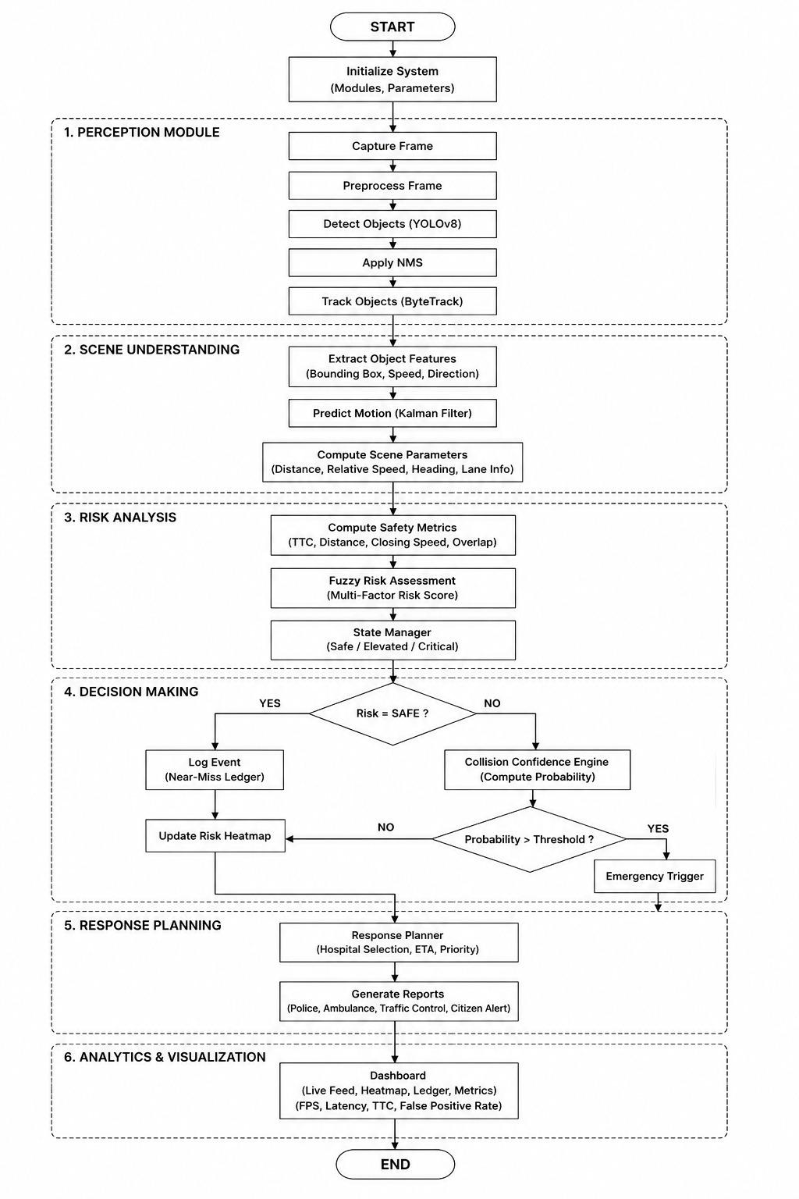
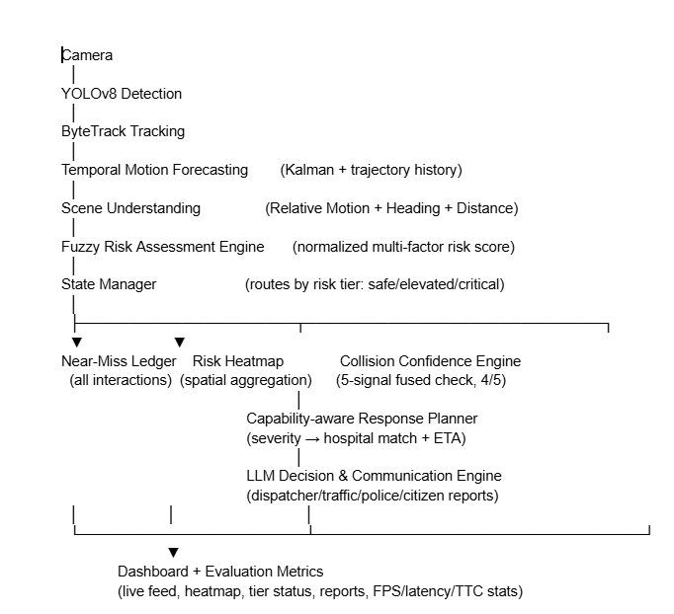
System Design
July 2026

Slide 5
Implementation Progress
Pipeline Stages Completed
Camera ingestion — live video feed capture
YOLOv8 object detection
ByteTrack multi-object tracking
Temporal motion forecasting (trajectory history)
Scene understanding (relative motion, heading, distance)
Fuzzy Risk Assessment Engine (normalized multi-factor risk score)
State Manager (risk-tier routing)
Near-Miss Ledger (interaction logging)
Collision Confidence Engine (multi-signal fused check)
Capability-aware Response Planner (severity to hospital match + ETA)
Remaining / In Progress
LLM Decision & Communication Engine and the live Dashboard — screenshots/demo to be added
July 2026

Slide 6
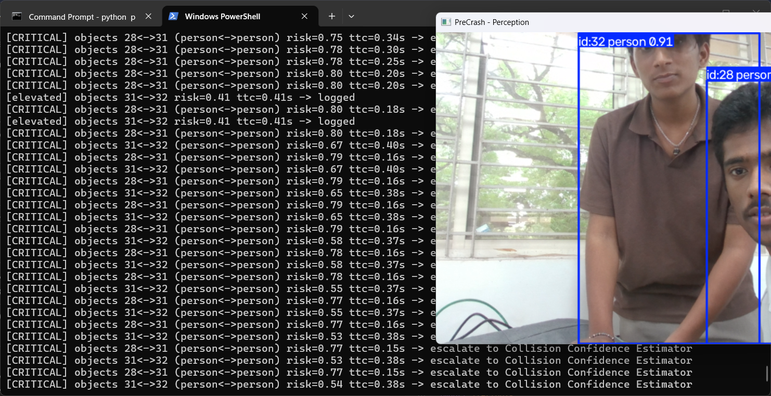
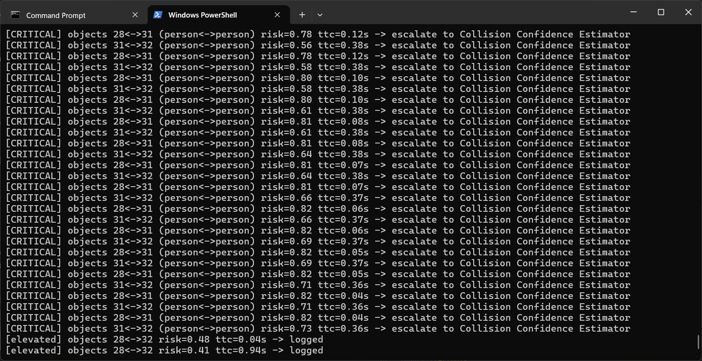
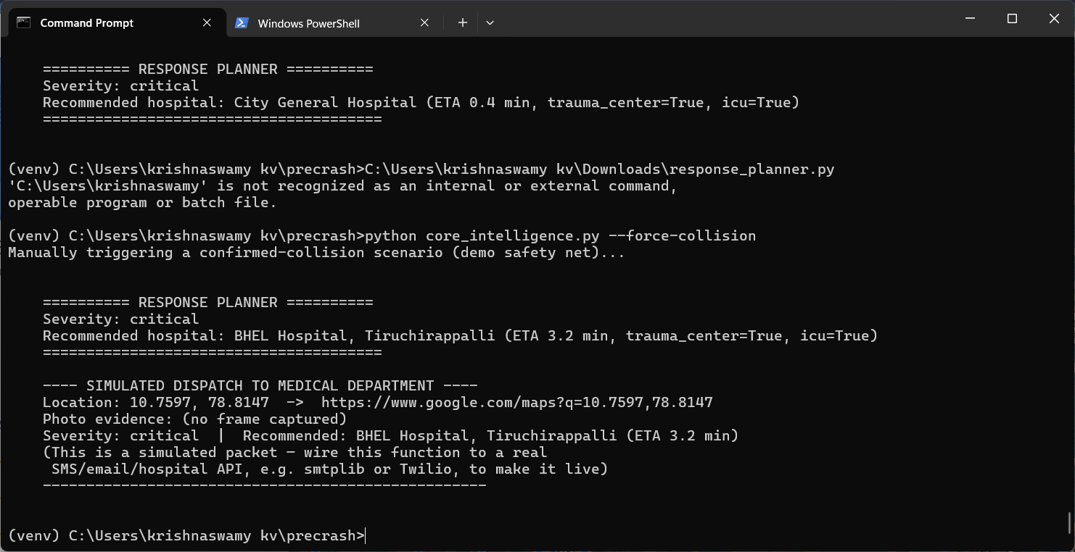
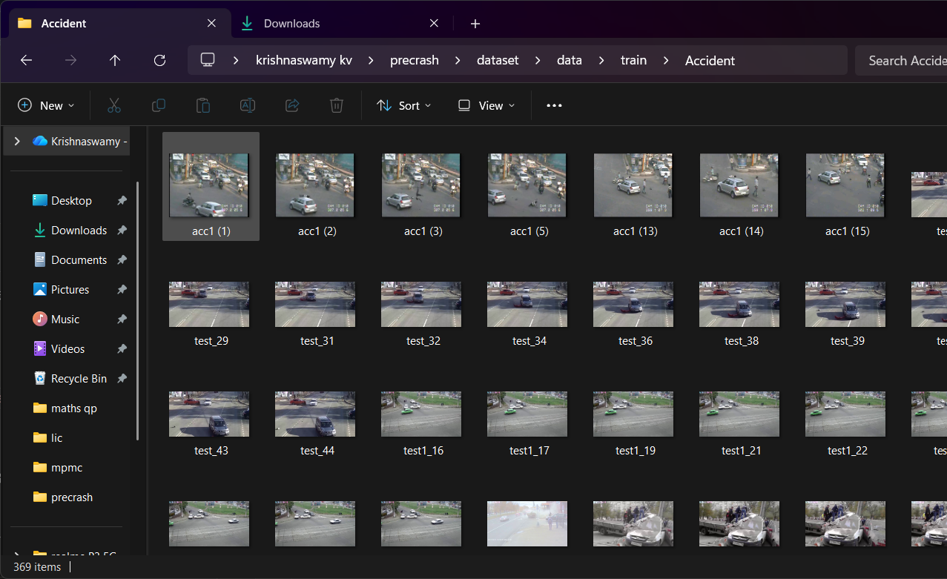
Implementation Progress
July 2026

